Slide 1

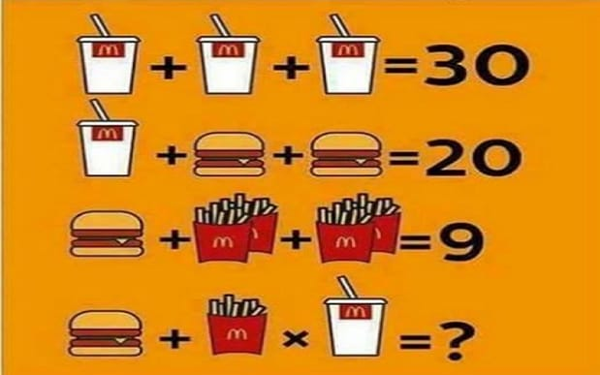
Do now
1. Get your things out
2.
3. Find as many words as you can:
DOIVRAERACUALPRAS
Reminders:
Phones away
Bags on floor
Books out
Pens out
Whiteboard
Reminders
Assessment next Tuesday: Research Methods and cognition test (5%)

Slide 2
Do now
Questions on content covered recently / revision.
Term | Description
 | Duration unlimited, capacity unlimited
 | A model of memory with 3 memory stores made by Atkinson and Shiffrin
 | A type of rehearsal used to keep information in the short-term memroy
 | duration less than a second, capacity unlimited
 | A type of rehearsal where information is connected to previously learned information
Reminders:
Phones away
Bags on floor
Books out
Pens out
Whiteboard
Reminders
Assessment next Tuesday: Research Methods and cognition test (5%)

Slide 3
Do now
Answer
Term | Description
Long-term memory | Duration unlimited, capacity unlimited
Multi-Store model of memory | A model of memory with 3 memory stores made by Atkinson and Shiffrin
Maintenance rehearsal | A type of rehearsal used to keep information in the short-term memory
Sensory memory | duration less than a second, capacity unlimited
Elaborative rehearsal | A type of rehearsal where information is connected to previously learned information
Reminders:
Phones away
Bags on floor
Books out
Pens out
Whiteboard
Reminders
Assessment next Monday: Research Methods and cognition test (5%)

Slide 4
Do now
Answer
For each of the following memories state what type of long term memory it is:
Describing your first day of year 7 (answer explicit / episodic memory)
Planning where to move your queen in a chess game
Walking on stilts up stairs
Recalling the name of Santas reindeer
Texting a phone message
Describing the plot of a novel
Reminders:
Phones away
Bags on floor
Books out
Pens out
Whiteboard
Reminders
Assessment next Monday: Research Methods and cognition test (5%)

Slide 5

Learning Intentions
Identify and describe the different types of retrieval.
Outline the different aspects of the working memory model
Compare the multi-store model of memory and the working memory model

Slide 6
The multi-store model of memory
(Atkinson & Shiffrin, 1968)
Vocabulary
model: a simplified way of explaining or representing a process or concept memory: the internal record of some previous event or experience retrieval: the recovery of information stored in the brain
Concept Development
Retrieval (remembering)
Remembering refers to the retrieval of information from our memories. Research has shown that the amount of information that we can retrieve from our memories depends on the sort of questions that we ask.
There are three main ways of measuring what a person has remembered:
Recall
Recognition
Relearning
Checking for understanding:
What does the amount of information we can retrieve from our memories depend on?

Slide 7
The multi-store model of memory
(Atkinson & Shiffrin, 1968)
Vocabulary
model: a simplified way of explaining or representing a process or concept memory: the internal record of some previous event or experience retrieval: the recovery of information stored in the brain
Retrieval
Recall:
Recall questions ask you to retrieve information from memory without any prompts or cues.
E.g. Who won the women’s 400m race at the Sydney Olympics?
Recognition:
Recognition questions ask you to identify information from a number of options (multiple choice).
E.g. Which of these women won the women’s 400m race at the Sydney Olympics: Katherine Merry, Lorraine Graham, Cathy Freeman, Ana Guevara.
There is a lot of research that shows that regardless of the type of information to be remembered, people find recognition easier than recall. This is why students prefer multi-choice questions to essay/short-answer questions, why most find it easier to recognise a person’s face than recall their name, and why people make fewer mistakes reading than they do spelling.
Concept Development
Checking for understanding:
What is the difference between recall questioning and recognition questioning? Which type of questioning is more effective in getting people to retrieve information

Slide 8
QUESTION 3
Which of the following is NOT a way to encode information?
Meaning (words)
Echoic
Iconic
Somatic

Slide 9
QUESTION 3
Which of the following is NOT a way to encode information?
Meaning (words)
Echoic
Iconic
Somatic
Is this an example of recall or recognition retrieval?

Slide 10
The multi-store model of memory
(Atkinson & Shiffrin, 1968)
Vocabulary
model: a simplified way of explaining or representing a process or concept memory: the internal record of some previous event or experience retrieval: the recovery of information stored in the brain
Retrieval
Relearning
There are many times when we seem unable to retrieve something we have seen or heard from memory, even with the help of cues or prompts. This doesn’t necessarily mean that we have totally forgotten this information.
Psychologists have devised a technique called relearning (the method of savings) to see if any information has been retained.
This method involves a person relearning information they have previously learned – if the information is learned more quickly the second time, it is assumed that some information must have been retained.
Concept Development
Checking for understanding:
Explain how relearning proves that some information has been retained.

Slide 11
Learning Intentions
Identify and describe the different types of retrieval.
Outline the different aspects of the working memory model
Compare the multi-store model of memory and the working memory model

Slide 12
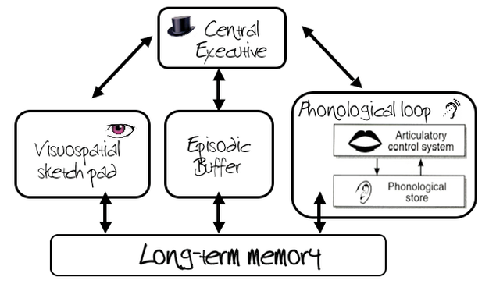
The working memory model
Vocabulary
model: a simplified way of explaining or representing a process or concept memory: the internal record of some previous event or experience retrieval: the recovery of information stored in the brain
Atkinson’s and Shiffrin’s (1968) multi-store model was extremely successful in terms of the amount of research it generated. However, Baddeley and Hitch (1974) argue that the picture of short-term memory (STM) provided by the Multi-Store Model is far too simple.
Overview of Working Memory:
- The new model for short-term memory
- Working memory is important for reasoning, learning and comprehension.
- Working memory theories assume that complex reasoning and learning tasks require a mental workspace to hold and manipulate information.
- Working memory is a multi-component system which includes the central executive, visuospatial sketchpad, phonological loop, and episodic buffer.
Concept Development
Checking for understanding:
Why was another model of memory created? How many components to the working memory model

Slide 13
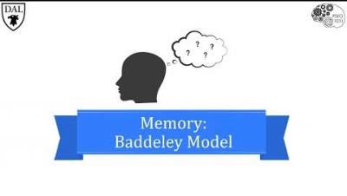
Working Memory model
Concept Development

Slide 14
The working memory model
Vocabulary
model: a simplified way of explaining or representing a process or concept memory: the internal record of some previous event or experience retrieval: the recovery of information stored in the brain
Concept Development
TASK
1. Draw the model in your book and explain what each part does:
Central executive, Phonological loop, Visuo-Spatial Sketch Pad, Episodic Buffer
2. What evidence is there for the WM model?
Link on SEQTA
Checking for understanding:
Explain how relearning proves that some information has been retained.

Slide 15
Evaluating the Working Memory model
Concept Development
Support for the model | Limitations of the model
Explains how we are able to parallel processes two different cognitive tasks at once (multi-tasking) unlike MSM | more detail of STM than the multi-store model, the WMM has been criticized for being too simplistic and vague, e.g. it is unclear what the central executive is, or its exact role in attention
brain-damaged patient KF could recall verbal but not visual information immediately after its presentation, which supports the WMM’s claim that separate short-term stores manage short-term phonological and visual memories. | Results from laboratory experiments researching the WMM will often have low ecological validity
model was developed based on evidence from laboratory experiments, so confounding variables could be carefully controlled to produce reliable results | Still no biological evidence of the working memory model. We aare unable to pinpoint structures that are accociated with the functions.
MSM – Multi-store model
WM- Working Memory model

Slide 16
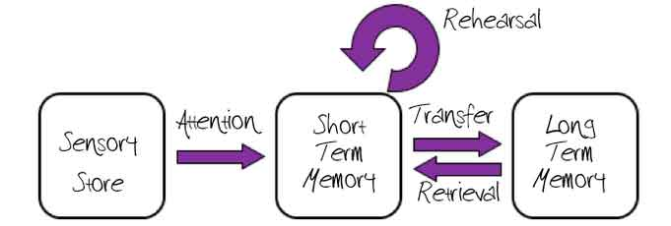
Evaluating the Multi-Store model
Concept Development
Support for the model | Limitations of the model
Miller (1957) Researched the capacity of STM which provides support for the claim that your STM holds 5-9 items and struggles past 9 items. Also found support for chunking of items in STM | A lot of research into MSM is from a lab and thus low ecological validity as memories are usually personal to you and meaningful and not a list of arbitrary words to recall.
Clive Wearing brain damage to the hippocampus. He could rehearse information for around 20 sec (maintenance rehearsal) but was unable to move anything to his LTM (elaborative rehearsal)
Case study of H.M. surgery to cure sever epilepsy, causing damage to the hippocampus. Unable to form new memories but could retrieve info from LTM, thus there are different stores for these functions
MSM – Multi-store model
WM- Working Memory model

Slide 17
Vocabulary
model: a simplified way of explaining or representing a process or concept memory: the internal record of some previous event or experience retrieval: the recovery of information stored in the brain
Comparing the two memory models
Concept Development
Finish the table:
Similarities | Differences
Both show how information is processed
Extension:
Research the advantages and disadvantages of both models of memory and note down two strengths and two limitations of both models.

Slide 18
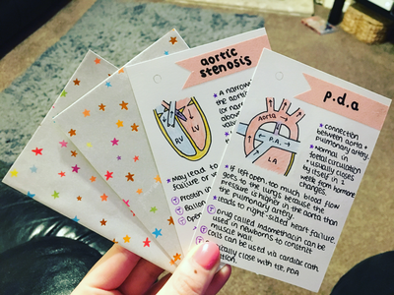
Strategy: Revising
LO: Explain the process of neural transmission (3.3)
Memories in the long-term memory last better when they are rehearsed through elaborative rehearsal: when they are linked to information that you already know!
Skill Development
Revision strategy examples and what they are good for:
Flashcards: definitions, theories, key words
Narratives and visuals: when you find info hard to understand / remember
Acronyms: Remembering information that has to be in a a specific order
Mindmaps: great for topic overviews
General tips:
Make it visual: pictures, tables, diagrams, headings and subheadings. Memory works better visually and this makes it easier to go over notes when you need them for exams
Colours: Also can be used to colour code: one colour for – definitions, evaluations, theorist names,
Get someone to test you
Stay consistent with even when you think you know it well
More ideas on revision techniques:
Click me for general tips
Click me on how to for mindmapping, flashcards etc
Click me for what elaborative rehearsal is

Slide 19

Exit Ticket
Fist to five and explain to partner

